Slide 1

Setting a MERN app :
Ecommerce website
Oumaima
Salhi

Slide 2

Introduction
Well the idea is to design an ecommerce website and put some products.
Let first discuss the topic of this project

Slide 3

A social networking site is an online platform that allows users to create a public profile and interact with other users. Social networking sites usually allow a new user to share, like and comment their and each other posts.
The actors and the use cases for this app are summarized in the following table:

Slide 4
The use Case Diagram study
Use CASE | ACTOR
Update product | User
Remove product | User
Add Product | User

Slide 5
The use Case Diagram study
USER
User can update product
User can delete or edit product
User can create a product

Slide 6
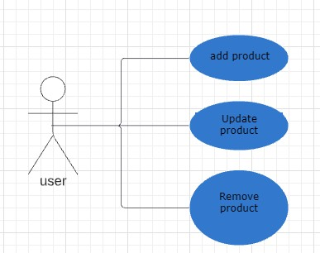

Slide 7
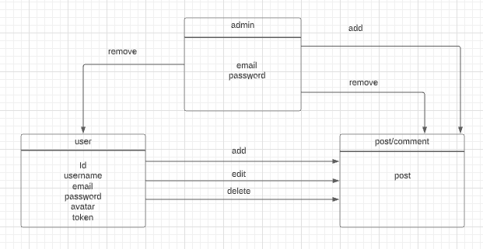

Slide 8
The Class Diagram Study
Users will be able to post and interact with each other in my app

Slide 9


